Slide 1
Docking with Docker
A Gentle Introduction on Docker

Slide 2
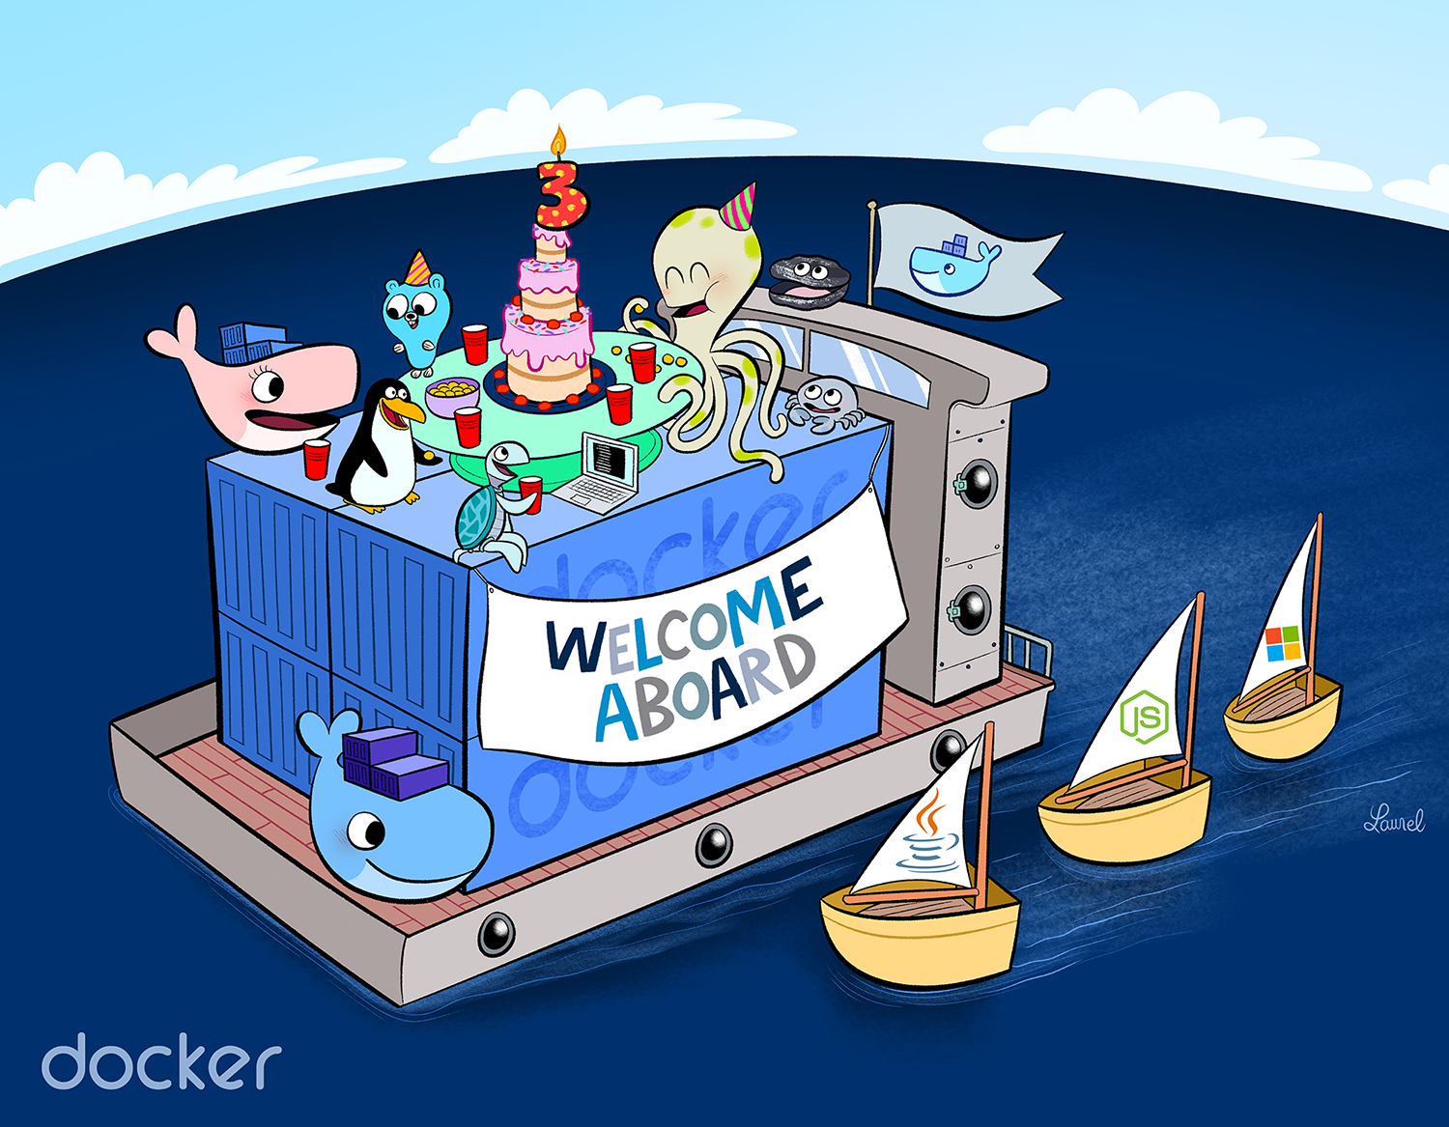
Agenda
Docker Overview
Popular Vocabularies
Some Geek Stuffs
More Technical Stuffs with live demos
Docker Compose with live demo
QA Session

Slide 3
Arnab
Software Engineer
Cefalo Bangladesh Ltd.
Consultant for NHST Global Team
Email: arnab.shil@nhst.com
Website: ruddra.com

Slide 4
Shovon
Software Engineer
Cefalo Bangladesh Ltd.
Consultant for NHST Global Team
Email: arshovon@nhst.com
Website: linkedin.com/in/arshovon

Slide 5
Docker Overview
Why you need us to use Docker?

Slide 6
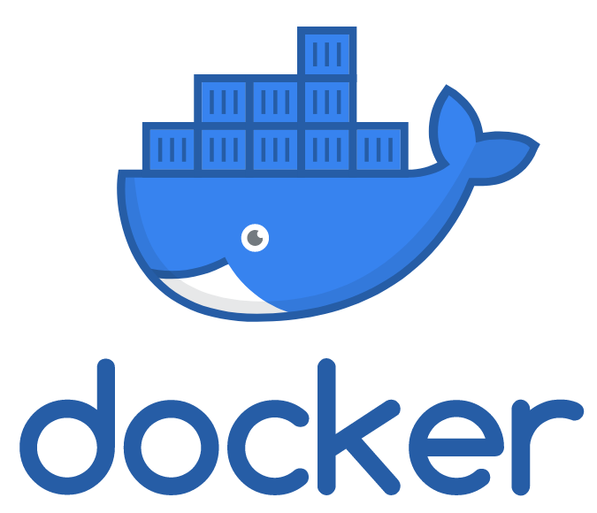
What is Docker?
An open platform to build, ship, and run distributed applications, whether on laptops, data center VMs, or the cloud.
Automates the deployment of applications inside containers.

Slide 7
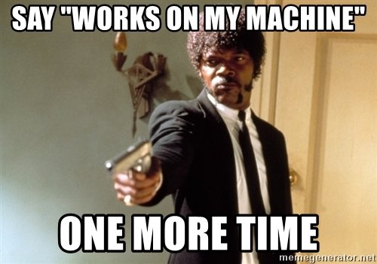
Development Setup != Production Setup (<2014 B.D.)

Slide 8
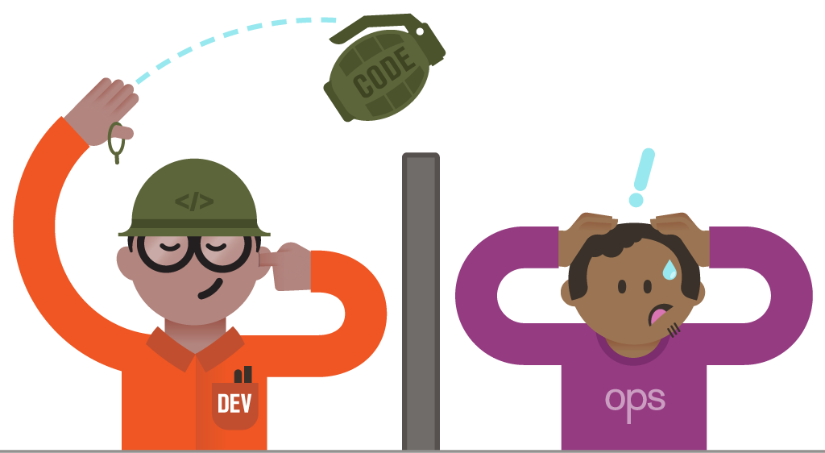
War between Developer and Operator

Slide 9
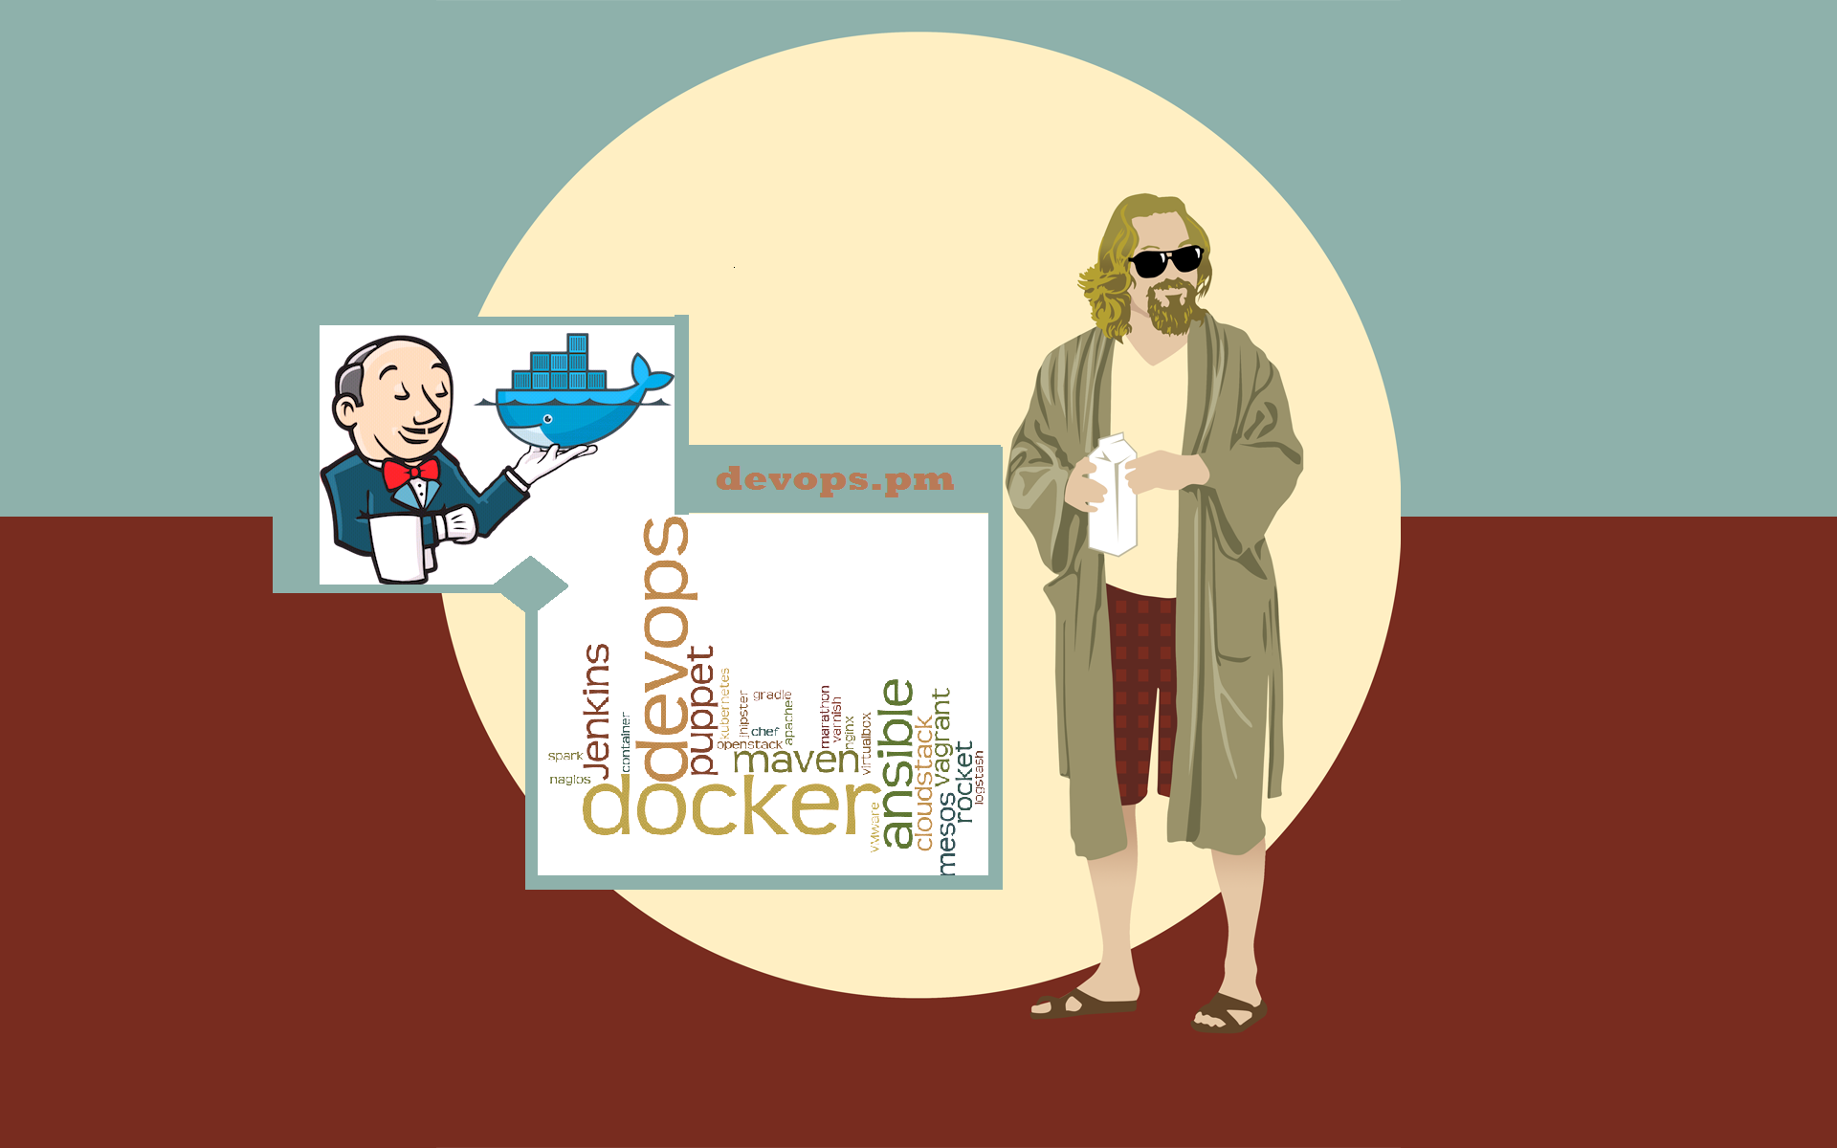
Here Comes The Super Chief: Mr. Docker :)

Slide 10
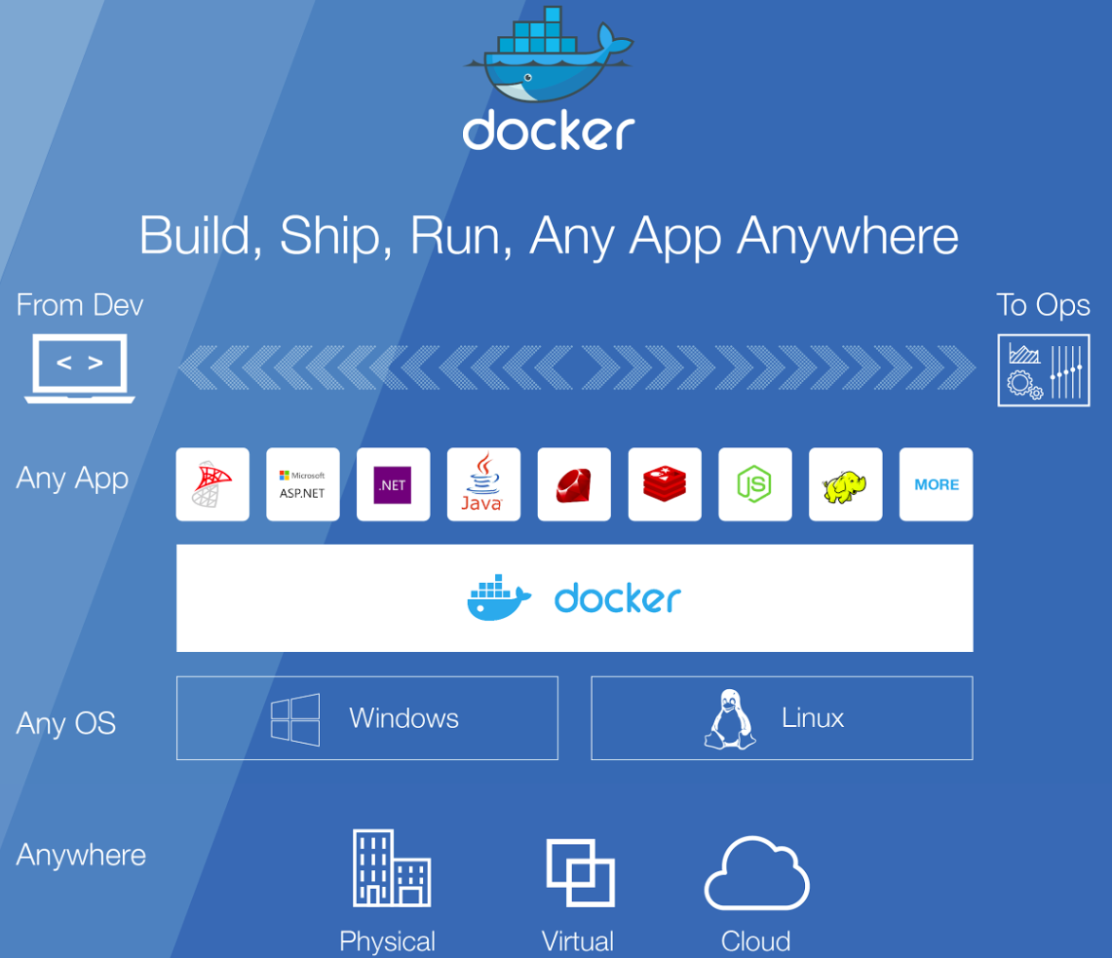
Why Docker?
Same setup everywhere
Rapid deployment
Easy maintainability
Faster configurations

Slide 11
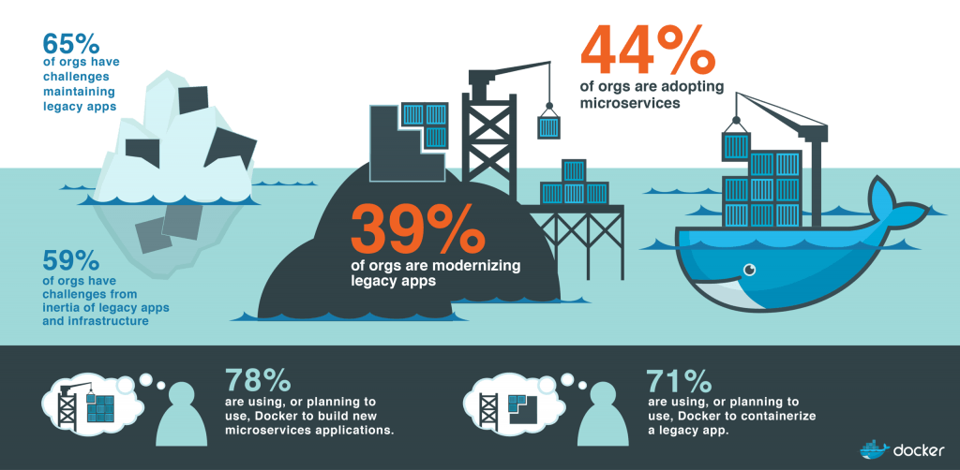
Docker Trends

Slide 12
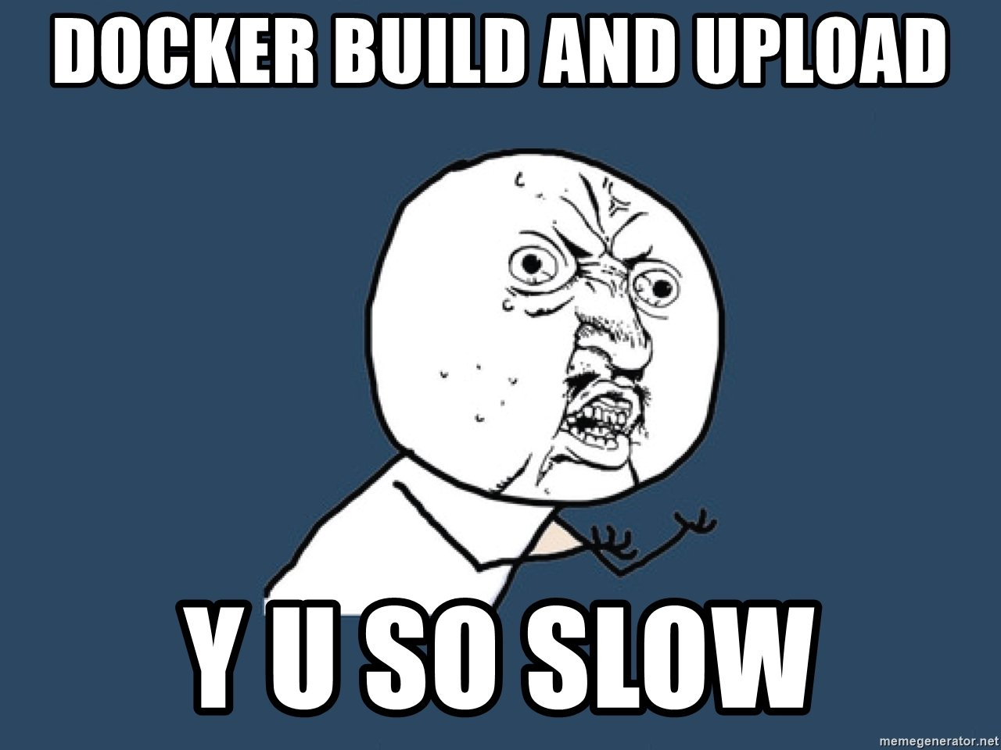
Docker Disadvantages
Slow build process
Connect to existing services
Resource consumption

Slide 13
Docker Vocabularies
Docker Container
A standardized unit of software
Provides OS level virtualization
Docker Hub / Store
Share images using Docker Hub repositories
Buy certified images from Docker store**
Docker Image
Includes code, libraries & environment
Container is a runtime instance of an image
Docker Volume
Define data volumes for a service
Persist even when containers are terminated

Slide 14
Geek Stuffs
Details on Docker’s Internal things

Slide 15
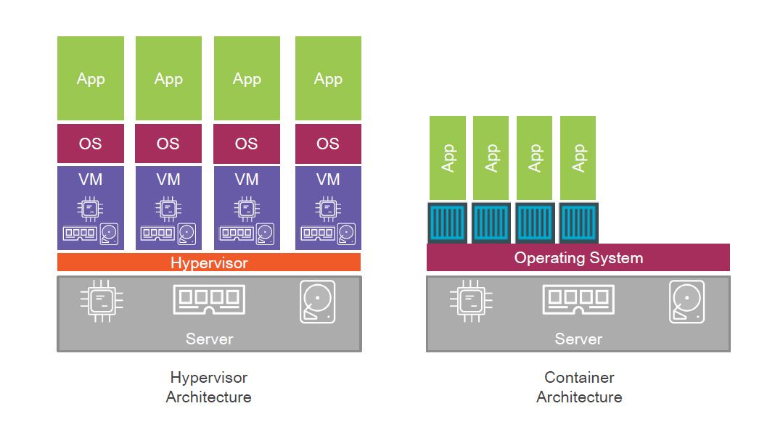
Difference between Virtualization and Containerization

Slide 16
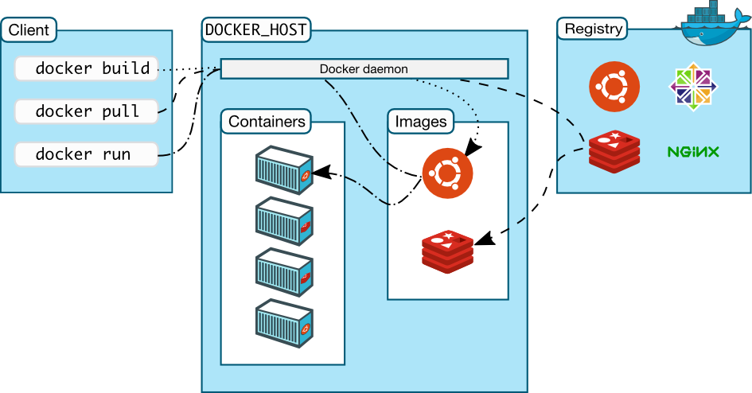
Docker Architecture

Slide 17
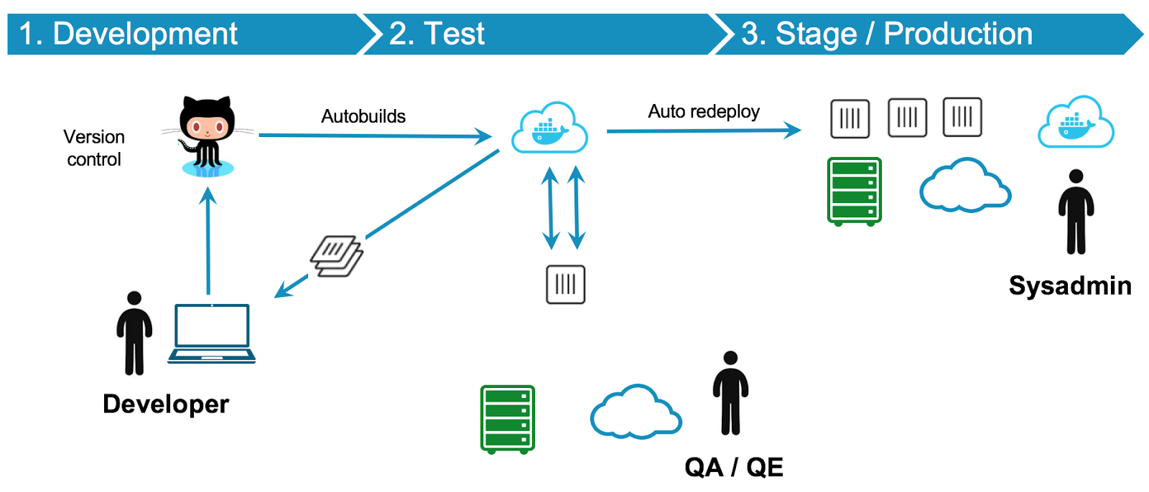
Continuous Integration (CI) & Continuous Deployment (CD) Workflow
Notes:
https://blog.docker.com/2016/04/cicd-with-docker-cloud/

Slide 18
More Technical Stuff
Run docker in your machine

Slide 19
Docker Install
MacOs: https://docs.docker.com/docker-for-mac/install/#download-docker-for-mac
Windows:
https://docs.docker.com/docker-for-windows/install/
Ubuntu:
https://docs.docker.com/install/linux/docker-ce/ubuntu/#install-using-the-repository

Slide 20
Docker Pull
Docker Pull means to pull image from dockerhub registry(hub.docker.com).
Command:
docker pull <image-name>:<tag>
Example:
docker pull mysql:latest

Slide 21
Docker Build
What is Docker Build?
Building Image from a Dockerfile.

Slide 22
Build From Remote Source(Git)
Command:
docker build <git-repository-link>#<branch_name> -t=”image-name”
Example:
docker build https://github.com/ruddra/docker-example.git#build-from-remote -t='docker-remote'

Slide 23
Custom Dockerfile
#Dockerfile Example
from python:latest
add . /code
WORKDIR /code
RUN pip install -r requirements.pip
EXPOSE 5000
CMD python flask_app.py

Slide 24
Build Within Local Machine
Command:
docker build <path-to-docker-file> -t=”<image-name>”

Slide 25
Docker Run
Command:
docker run <image-name> <docker-port>:<local-machine-port>

Slide 26
Docker Set Environment Variable
Command:
docker run -e <ENVIRONMENT-VARIABLE-1>=<VALUE-1> <ENVIRONMENT-VARIABLE-2>=<VALUE-2> <image-name>
Example:
docker run -e MYSQL_ROOT_PASSWORD=root -e MYSQL_USER=root -e MYSQL_PASSWORD=root -e MYSQL_DATABASE=mydb mysql

Slide 27
Docker Hub AKA Docker Cloud
Login Command:
docker login
Tag your Image for Docker Hub:
docker tag my_image $DOCKER_ID_USER/my_image
Push your Image to Docker Hub:
docker push $DOCKER_ID_USER/my_image
Push your Image for Docker Hub:
docker pull $DOCKER_ID_USER/my_image

Slide 28
Docker Useful Commands
Remove Container:
docker rm <container-id>
Show running container:
docker ps
Show all containers:
docker ps -a
Docker shell:
docker exec -it <container-id-OR-name> bash

Slide 29
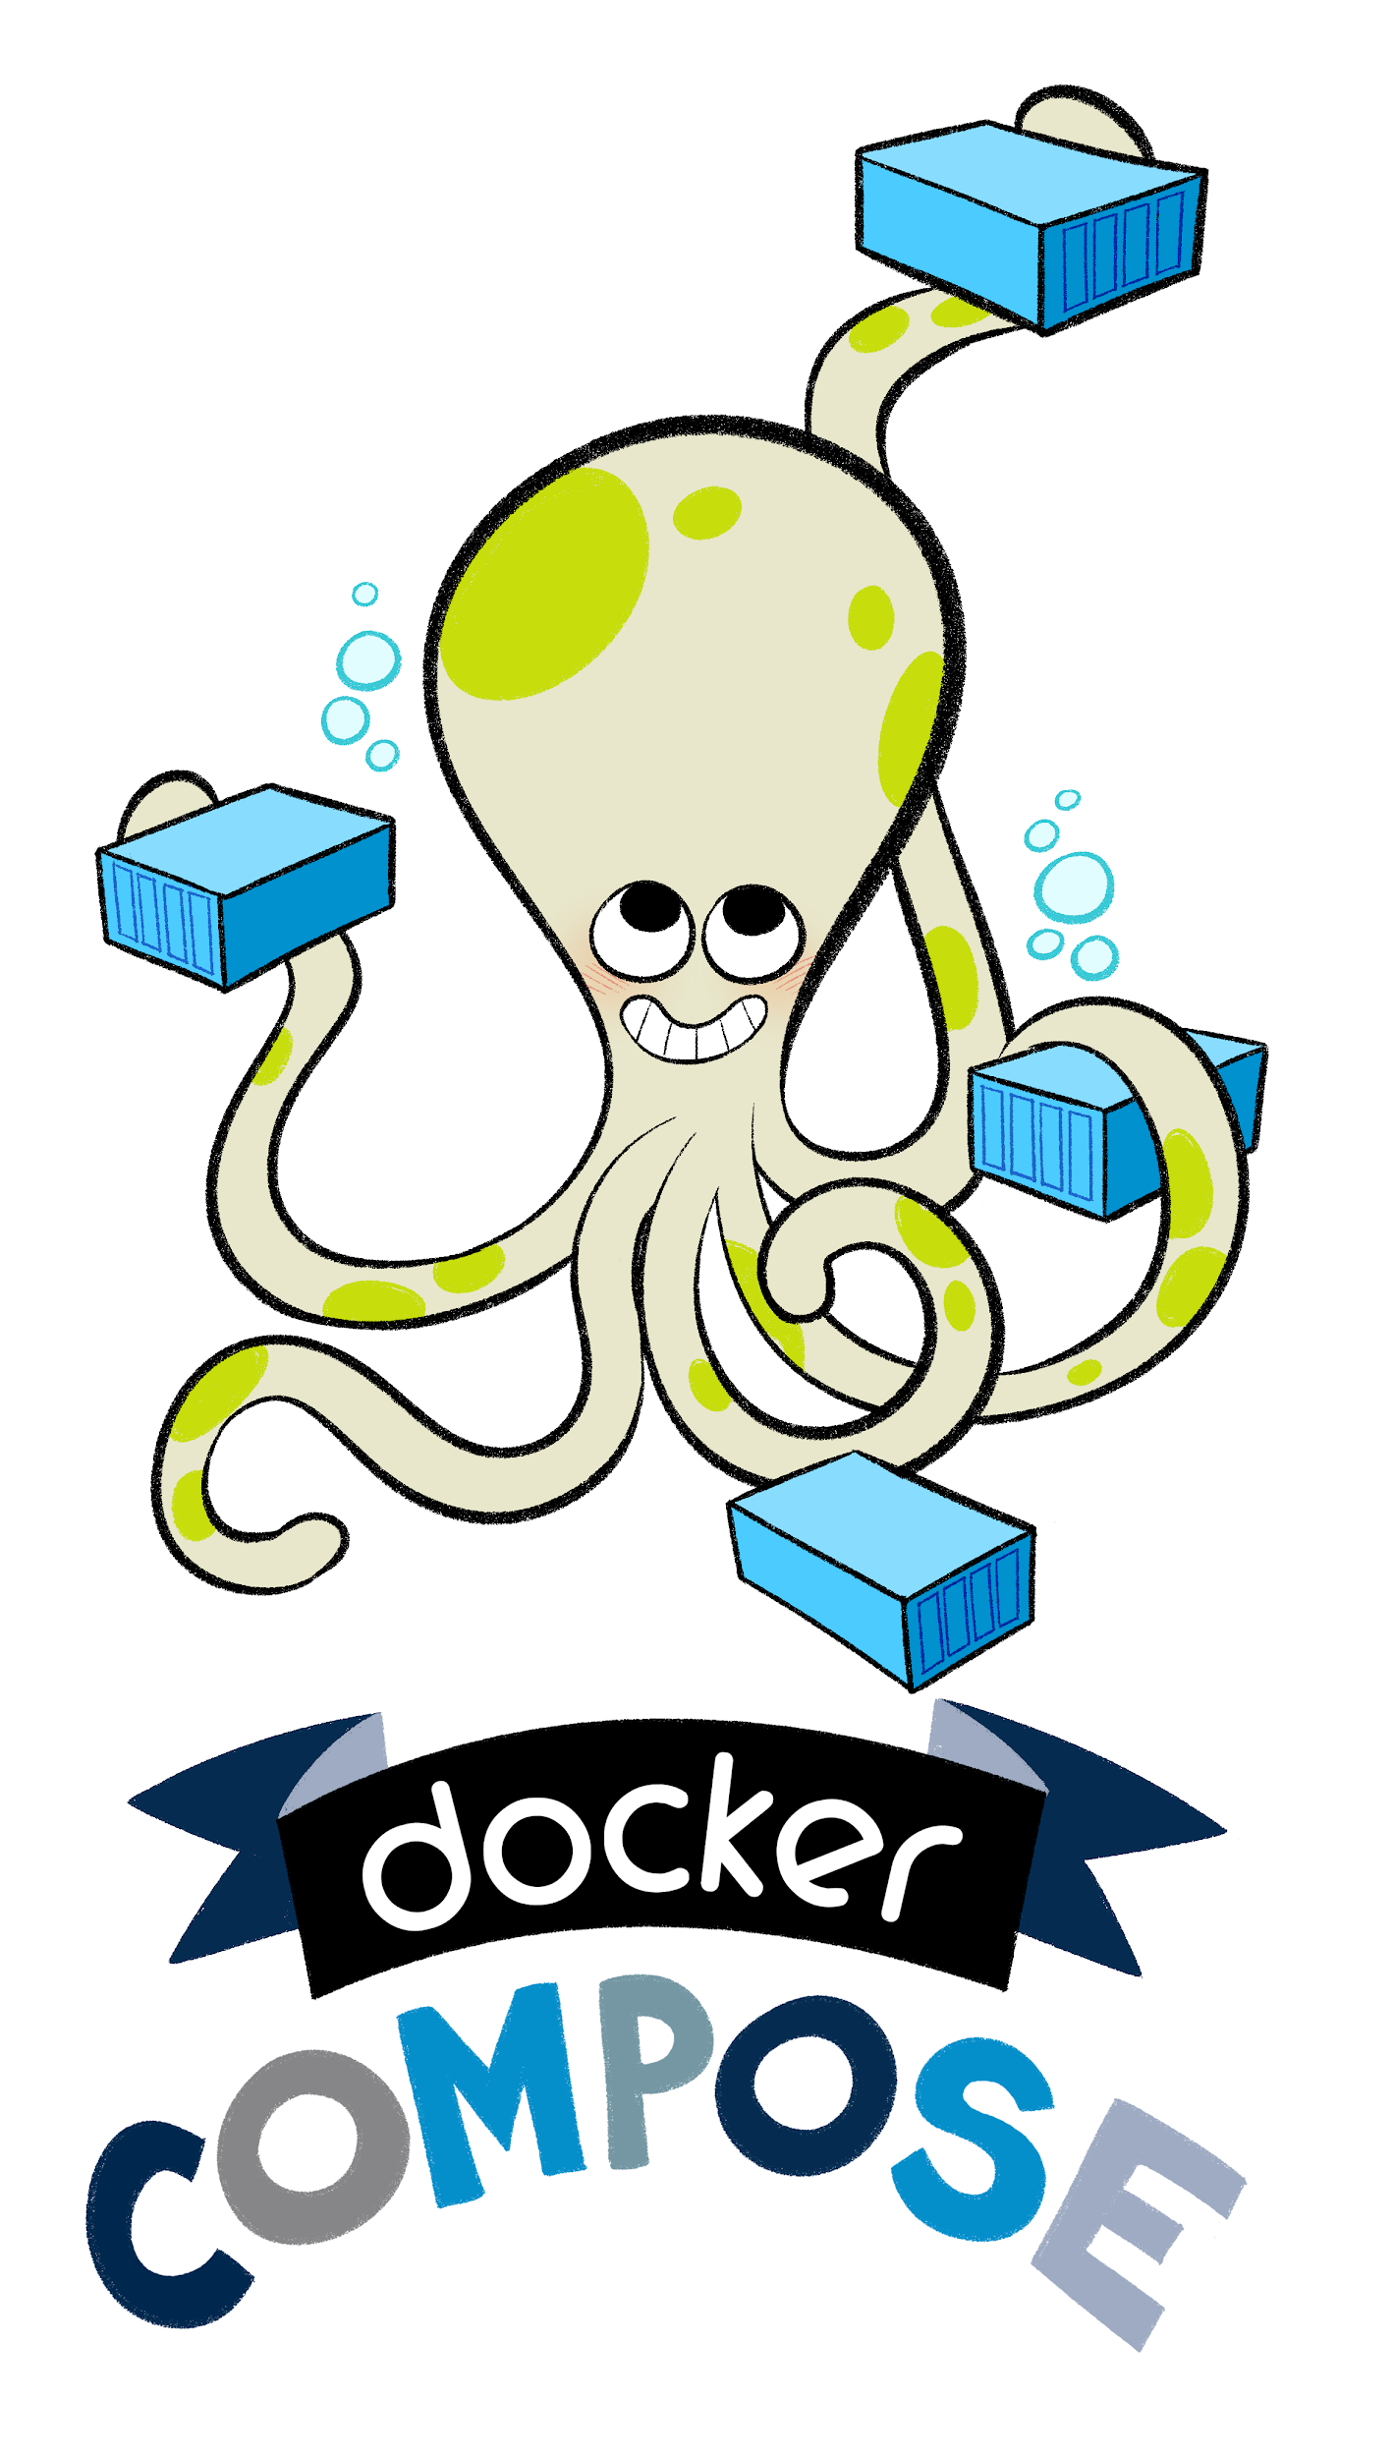
Docker Compose
Tool for defining and running multi-container Docker applications
Use a YAML file to configure application’s services
Call all the services using single command
Same everywhere:
Production
Staging
Development
Testing
CI

Slide 30
Docker Compose Useful Commands
Build Containers:
docker-compose build
Create and start containers:
docker-compose up
Stop and remove containers, networks, images, and volumes:
docker-compose down
Execute a command in a running container:
docker-compose exec

Slide 31
Docker Compose Useful Commands (Continue)
Start services:
docker-compose start
Stop services:
docker-compose stop
Restart services:
docker-compose restart
Remove stopped containers:
docker-compose rm

Slide 32
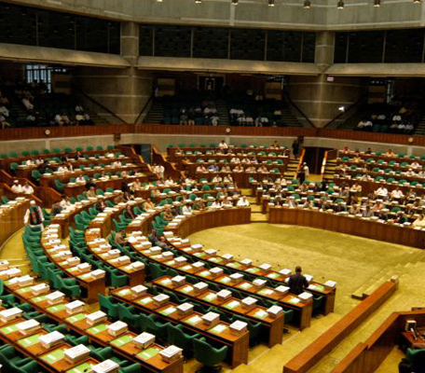
Questions Time

Slide 33
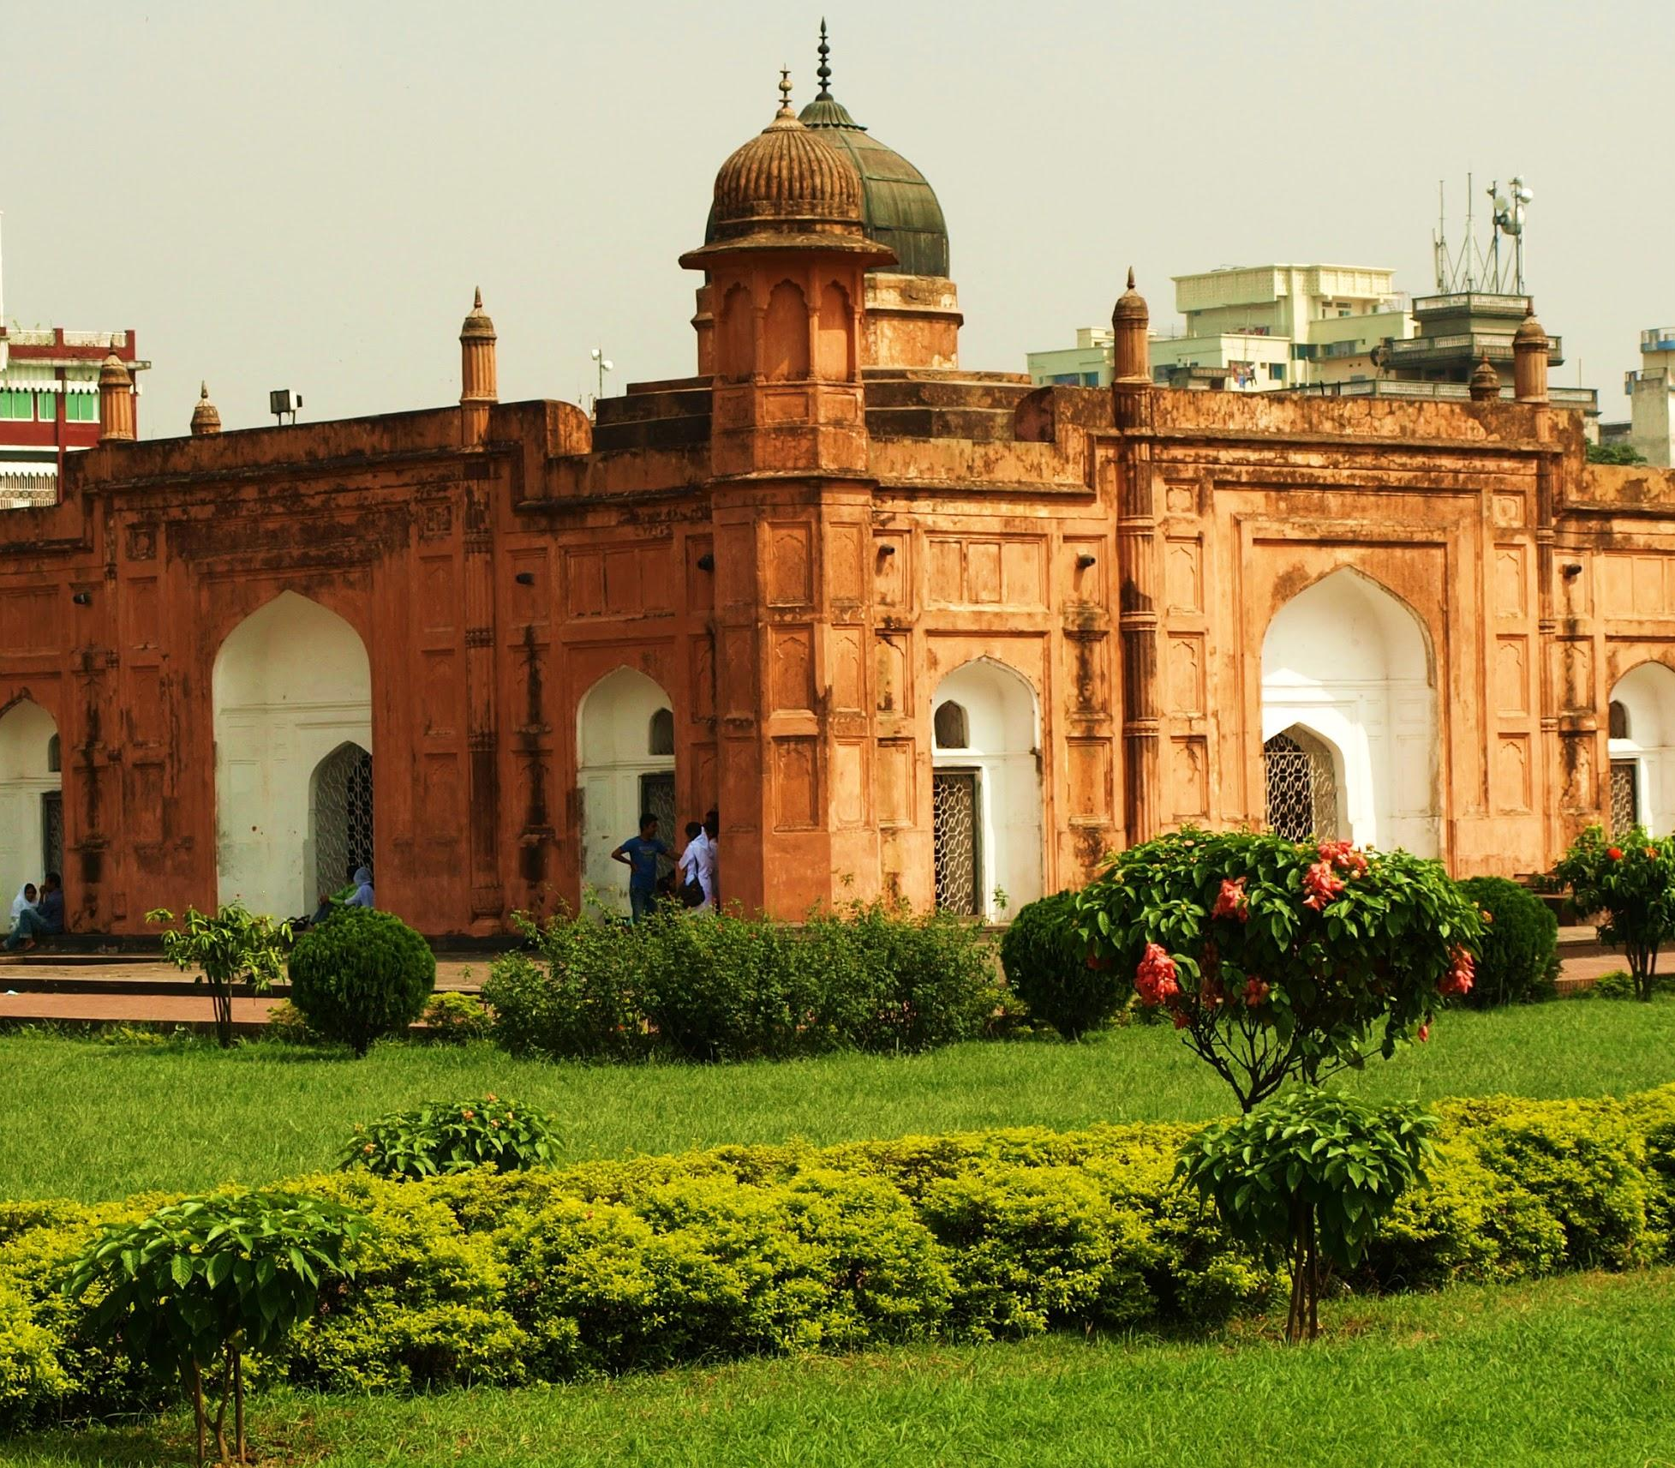
Thank you
Please don’t ask more questions :)

